Slide 1

Thematic PowerPoint
Topic: Women
Chapters 1-9
By: Jamie McMillan

Slide 2
Let us start at the very beginning…

Slide 3
Vocabulary words to know CH1-3
Matrilineal: living with female’s family
Patrilineal: living with male’s family
Vision Quest: a spiritual journey a young Native American goes on where they sought out personal protective spirits by going alone into the wilderness exposing themselves to the elements, fasting, and inducing hallucinations and dreams.
Salem Witch Trials: In Salem, Massachusetts 1692, when a group of girls claimed to have been bewitched by old men and women, the whole community was thrown into a panic of accusations. 20 people had been tried, condemned and executed
Longhouse: a communal living arrangement where matrilineal lines of generations lived

Slide 4
Native American Women
Desert communities were characterized by a general social equality. Women in one hand married men from another tribe. Wives went to live with the people of their husbands, creating important linkages between the groups.
Gathering food and maintenance of home-base camps were the responsibility of women whereas hunting was work for men.
  However when communities became almost completely dependent on crops, men and women both worked in fields. Women were mainly responsible for the fields
  When English colonists saw Indian women working in the cornfields, they thought them greatly oppressed; Indians on the other hand thought colonial men who labored in the fields were performing “women’s work.’
In most North American Indian farming communities, women and men belonged to separate groups, each with its own rituals and lore.
When divorced, children always remained with mother. Women were free to determine the timing of reproduction as well as to use herbs to prevent pregnancy, induce abortion, or ease the pain of child birth
  Status and role of Indian women were strikingly different from European patterns; men rule over women and fathers over households was the normal.
In the East, archaeologists found axes, fish hooks, and animal bones with males; nut-cracking stones, beads and pestles with the females- reflecting the different roles of men and women in their society

Slide 5
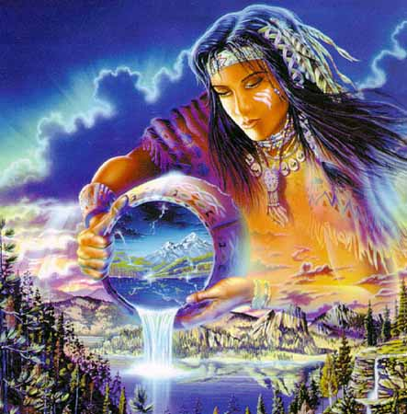
religions of foragers and farmers
Young women and men had to embark on a “vision quest” where they sought out personal protective spirits by going alone into the wilderness exposing themselves to the elements, fasting, and inducing hallucinations and dreams.
  An individual who developed a special sensitivity to spiritual forces might become a shaman to the community-woman or man

Slide 6
South
Northeast
Communities in FL were hierarchical with classes and hereditary chiefs, some of whom were women.
Women controlled household and village life and were influential as well in the matrilineal clans that linked communities together.
After harvest festival, villages, clans, and groups of men and women competed against each other in the ancient stick-and-ball game (aka lacrosse) and in the evening men and women played chunkey, a gambling game
Iroquois women produced crops of corn, beans, squash, and sunflowers sufficient to support 50 longhouses, each occupied by a matrilineal extended family.
Women played important roles in choosing male leaders who would represent their lineages and chiefdom on the Iroquois council.

Slide 7
European communities

Slide 8
European Women
Women were responsible for child care, livestock, and food preparation. A woman’s family gave her a dowry but in general they were excluded from inheritance
Some housewives independently traded garden products, milk, and eggs. Women traders helped create and sustain many of the bonds of new England communities
The average woman, married in her 20s survived through her 40s and could expect to expect to bear 8 children
Wives who failed to have children or widows were economically independent.
Many women were accused of witchcraft and executed. The majority was childless or widowed or had the reputation of assertiveness and independence.
  In Salem, Massachusetts 1692, when a group of girls claimed to have been bewitched by old men and women, the whole community was thrown into a panic of accusations. Governor stopped persecutions I 1693. 20 people had been tried, condemned and executed

Slide 9
Important women
“Bloody Mary” came to power after her brother, Edward VI died. She tried to reverse Henry VIII reformation. Martyring hundreds of English Protestants and gaining the title.
Elizabeth I ascended the throne after Mary. Although she outlawed Catholicism, Elizabeth sought to end the religious turmoil by tolerating a variety of views within the English church
Isabella of Spain: permitted Columbus expedition
Pocahontas: not the Disney story
Anne Hutchinson led discussion groups the criticized various Boston ministers for a lack of piety. She was called before the General Court, where Puritan leaders made it clear they could not tolerate a woman who publically criticized men.

Slide 10
Two Women of Importance

Slide 11
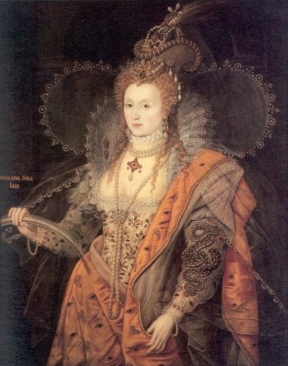
Elizabeth I
Elizabeth I came to thrown after her catholic half sister Mary (“Bloody Mary”) died.
Although Elizabeth I outlawed Catholicism, Elizabeth sought to end the religious turmoil by tolerating a variety of views within the English church. Criticized by racial Protestants for not going far enough and condemned by Catholics for her “pretended title to kingdom,” Elizabeth nevertheless gained popularity among the English people with her moderate approach.
The Spanish monarchy declared itself defender of the Catholic faith and vowed to overthrow her.

Slide 12
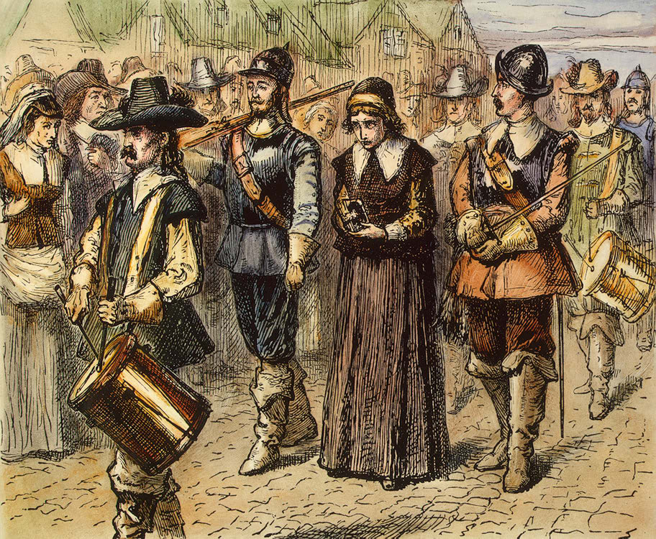
Anne Hutchinson
Anne Hutchinson lived in Massachusetts Bay with 14 children.
led religious discussion groups the criticized various Boston ministers for a lack of piety.
The concentration of attention on good works, she argued, led people to believe that they could earn their way to heaven, a “popish” or catholic heresy in the eyes of Calvinists.
She was called before the General Court, where Puritan leaders made it clear they could not tolerate a woman who publically criticized men.
She could be considered the first feminist

Slide 13


Slide 14
Click for answers
What kind of living arrangements was prevalent in Native American households?
  Patrilineal
  Nuclear family
  Matrilineal
  Conjugal
Which of the following was NOT one of the Elder women’s possible jobs in Native American societies?
  Midwife
  Picking chiefs
  Shaman
  Chief

Slide 15
In European societies, what was the average marrying age for women?
  17
  25
  15
  20
The purpose of a “Vision Quest” was to…
  Get in touch with the spirits
  Fulfill a quest given by the chief
  Seek true beauty in nature
  Expand territory

Slide 16
Elizabeth I outlawed
  Protestants
  Puritans
  Catholicism
  Calvinism
European women were allowed to trade which of the following?
  Gardening products
  Jewelry
  Homemade items
  Clocks

Slide 17
When did the Salem witch trials take place?
  1704
  1607
  1692
  1645
Native American were allowed to do all of the following except
  Induce abortion
  Give children up for adoption
  Use herb as birth control
  Ease child birth

Slide 18
How many children was the average European woman expected to have?
  4
  10
  6
  8
Bloody Mary came to power after who died?
  Edward VI
  Henry VIII
  Edward VIII
  Henry VI

Slide 19
Moving on to slave and colonial women

Slide 20
Vocabulary words to know CH4-6
Now-wife: refers to a man's present wife as compared to those that he had previously lost in colonial times
Republican Motherhood: instilling in their children Republican values and ideals that would prepare them to be good citizen
Continental army: created to coordinate the American Revolution. The Continental Army was supplemented by local militias and other troops that remained under control of the individual states. Women were allowed to help.
Bars Fight: Lucy Terry’s poem, the earliest known work of literature by an African American and by a slave, was composed in 1746
Saboteurs: one of the job women were allowed to pursue during the revolutionary war: sabotaging the other side.

Slide 21
West Africans
men took 2nd and 3rd wives: polygamy
Because fewer African women bore children than typical European woman, many enjoyed independence as tradeswomen

Slide 22
Slavery
Captains inspected each man and woman and those selected for transport were branded on the back or buttocks with a mark from the buyer
After breakfast, men & women were commanded to jump up and down in a bizarre session for exercise. Also known as “Dancing the Slave”
For every woman taken captive, another died in a chronic slave raiding
1662 colonial officials declared that children inherited the status of their slave mothers.
Slave codes didn’t provide for legal slave marriages that would contradict the masters’ freedom to dispose of his property at will.
Slave codes didn’t provide for legal slave marriages that would contradict the masters’ freedom to dispose of his property at will.
Slave couples married when woman was pregnant
“the man make the woman a present, such as a brass ring or some toy, which she accepts of and becomes his wife”- marriages weren’t through government
Slave couples married when woman was pregnant
“the man make the woman a present, such as a brass ring or some toy, which she accepts of and becomes his wife”- marriages weren’t through government

Slide 23
Women in Society
Some farm women were independent traders in dairy products or eggs
Other women became midwives and medicinal experts serving the community
Few opportunities outside the household
Colonial women played an active role in 18th century journalism due to widows succeeding their husbands in business.
Ministers often reminded their flock that women were inferior to men and more inclined to sin and error.
More often women were taught to read so that they could read the Bible but few learned to write as it was thought that there was no reason a woman should know how to write.

Slide 24
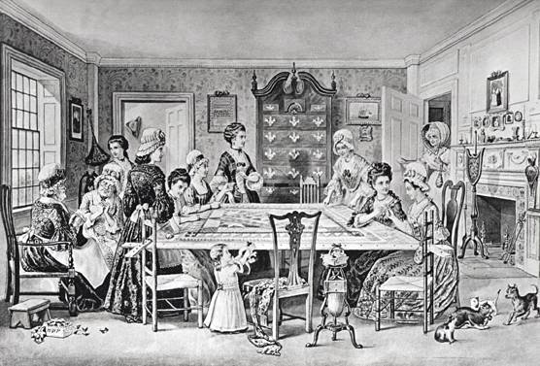
Quilting Bee
The Quilting Bee was an important means of socializing for colonial and pioneer women

Slide 25
Home life
White children were breast fed by African nannies
White women and African men had children often
It was common for women to bear 7 or more children due to high fertility
Wives were governed by husbands
Young girls were often married by the age of 13 or 14.
Women who were not married by the age of 25 were socially humiliated.
A woman was expected to be subservient to her father until she married and then to her husband
Women married mostly for social and economic reasons, not for romantic ones.
Once married, a woman became the legal property or chattel of her husband. Married women had no control of their earnings, inheritance, property, and also could not appear in court as a witness or vote. Husbands could legally beat their wives

Slide 26
Women in the public eye
Women could not vote in public office
1768 and 1769, colonial newspapers paid a great deal of attention to women’s support for the boycott. Groups of women, some styling themselves Daughters of Liberty, organized spinning and weaving bees to produce homespun for local consumption.
The actual work performed at these bees was less important than the symbolic message.
Other women renounced silks and satins and pledged to stop serving tea to their husbands

Slide 27
Two Women of Importance

Slide 28
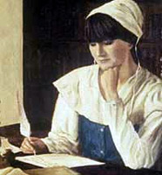
Anne Bradstreet
Anne Bradstreet is considered by many to be the first American poet.
Her first collection of poems, "The Tenth Muse Lately Sprung Up in America, By a Gentlewoman of Those Parts", it was the first book written by a woman to be published in the United States.
Mrs. Bradstreet's work also serves as a document of the struggles of a Puritan wife against the hardships of New England colonial life, and in some way is a testament to plight of the women of the age.

Slide 29

Deborah Sampson
Deborah Sampson disguised herself, and, as a man named Robert Shirtilife.
She served during the whole of the Revolutionary war.
She was wounded twice; but her secret remained undiscovered, till, during brain-fever, her sex was discovered by the physician.
No picture available
But this is close…

Slide 30


Slide 31
Wives were governed by all of the following except
  Husbands
  Government
  House hold laws
  Religion
Women were considered an embarrassment to their family if they were unmarried by the age of…
  19
  27
  23
  25

Slide 32
Anne Bradstreet’s first collection of poems was named
  The Guidelines for Proper Conduct
  The Tenth Muse Lately Sprung Up in America, By a Gentlewoman of Those Parts
  The Eight Acts of America, Affects and Consequences
  The Times of the Republican Motherhood
A “now wife” is a
  Woman who is married against her will but with a large dowry
  The woman of the community who is unmarried, but is willing to marry anyone at whim
  A man's present wife as compared to those that he had previously lost.
  African women on slave ship that the crew allowed on deck

Slide 33
Which of the following was a community gathering for women?
  Quilting Bee
  Necklace crafting
  Trading household techniques
  Courthouse meetings
Children inherited what from their mothers?
  Money
  Property
  Status
  Debt

Slide 34
Few women were taught to read. The purpose for the women who did was to…
  Read the Bible
  Read legislature
  Read the newspaper
  Read books
“Bars Fight” was the first slavery literature written by
  Louise Hannon
  Tonosha Raquel
  Anne Bradstreet
  Lucy Terry

Slide 35
Average number of children for women to bare was
  10
  7
  9
  12
Women commonly married for all of the following reasons except…
  Romantic reasons
  Social reasons
  Political reasons
  Economic reasons

Slide 36
Women of the Revolution
Lets start a revolution

Slide 37
Vocabulary words to know CH7-9
Poems on Various Subjects, Religious and Moral: one of Phillis Wheatley’s poems that combined her piety with a concern for her people.
Republic: a state in which supreme power is held by the people and their elected representatives, and which has an elected or nominated president rather than a monarch.
Molly Pitcher: a woman named Mary Ludwig Hays who took her husband place at cannon during a battle.
Constitution of New Jersey 1776: allowed women to vote for a short amount of time
Light troops: unencumbered, agile soldiers by contrast with the ‘heavy’ or line infantry and cavalry. Women joined this type.

Slide 38
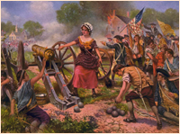
Women during the Revolution
Women assumed the management of farms and business as men went to war
Women volunteered as seamstresses, cooks, nurses, and spies
When fighting lengthened to years, many women left their homes to join husbands, lovers, brothers, and fathers in encampments. Some were officially employed, but most took care of their own men and many fought with them side by side
By giving the vote to “all free inhabitants” the 1776 constitution of New Jersey enfranchised women as well as men who met the propriety requirements. The number of women voter eventually led to male protests. In 1807 a new state law explicitly limited the right of franchise to “free white male citizens”
Some women participated directly in patriotic politics. For example, the Boston home of Mercy Otis Warren, the daughter of James Otis, was a center of Patriot political activity, and this dedicated revolutionary woman published a series of satires supporting the American cause and scorning loyalists.

Slide 39
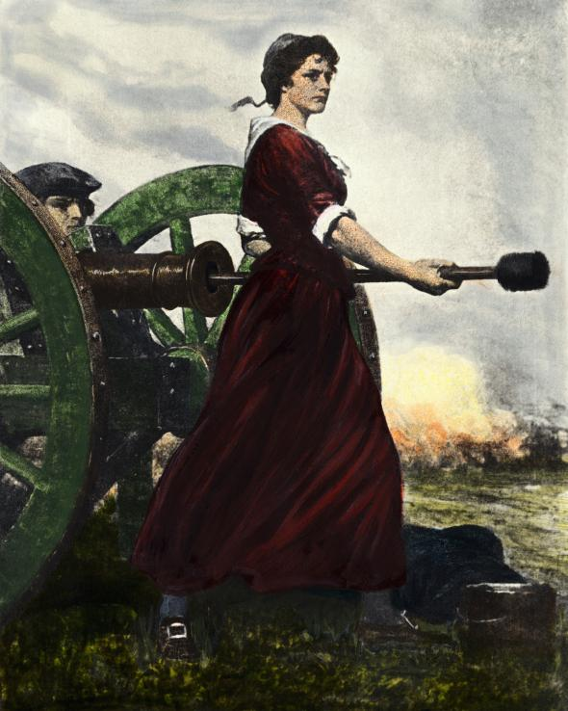
Important Women of the revolution
Mary Ludwig Hays earned the name “Molly Pitcher” for her courage in bringing water to the patriots during the battle of Monmouth in 1778. When her husband was overcome by heat, Mary took his place at cannon
Margret Barbin’s husband died in battle, she stepped into his position.
Deborah Sampson disguised her self as a man and enlisted
Phillis Weatley came to public attention when her Poems on Various Subjects, Religious and Moral appeared in London in 1773, while she was still a domestic slave in Boston. Kidnapped as a young girl and converted to Christianity during the Great Awakening, Wheatley wrote poems that combined her piety with a concern for her people.

Slide 40
Literacy in a new republic
In the aftermath of the revolution, Americans debated the issue of an expanded role for women in new republic. Many Federalists condemned “women of masculine minds,” but there was general agreement among both conservatives and democrats that the time had come for better education for American women
Literary demand for books that appealed to women in the 1790s
Although women’s literacy rates continues to be lower than men’s, they rose steadily as girls joined the boys in common schools
Some writers argued that the new republican order ought to provide new roles for women as well as for men.
English Feminist Judith Sarget Murray publically stated that women “should be taught to depend on their own efforts, for the procurement of an establishment in life.”
  “I expect to see our young women forming a new era in female history,” Murray preceded. Federalists listened to such opinions in horror. “Women of masculine minds,” one Boston minister said, “have generally masculine manners”

Slide 41

Education
There seemed to be a general agreement among all parties, however, that the time had come for better-educated and better-informed women. Republican institutions of self-government were widely thought to depend on wisdom and self-discipline of American people. Civic virtue must be taught at home.
By placing her learning at the service of her family, the “republican mother” was spared the criticism leveled at independent-minded women.
Thus women were provided the opportunity to be not simply “helpmates,” but people “learned and wise.” But they were also expected to be content with a narrow role, not to wish for fuller participation in American democracy

Slide 42
Two Women of Importance

Slide 43
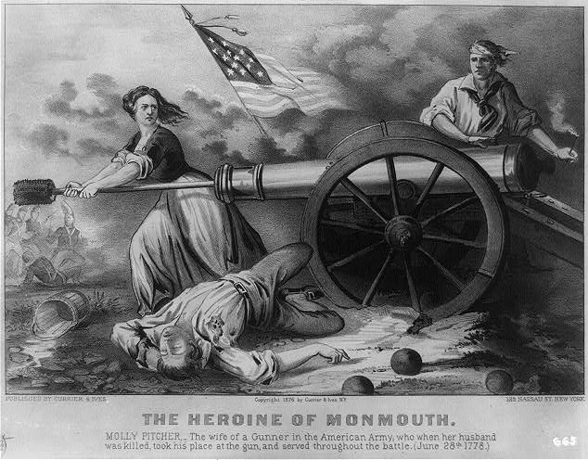
Mary Ludwig Hays
Mary Ludwig Hays earned the name “Molly Pitcher” for her courage in bringing water to the patriots during the battle of Monmouth in 1778. When her husband was overcome by heat, Mary took his place at cannon

Slide 44
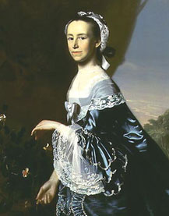
Mercy Otis Warren
Mercy Otis Warren was a center of Patriot political activity. This dedicated revolutionary woman published a series of satires supporting the American cause and scorning loyalists.

Slide 45


Slide 46
Molly Pitcher’s real name was
  Molly Pitcher
  Abigail Adams
  Margret Barbin
  Mary Ludwig Hays
the 1776 constitution of New Jersey
  gave women the right to vote
  made a lasting impact on society
  allowed mothers to have full custody of children
  made men and women equal in their household

Slide 47
Mercy Otis Warren wrote which of the following
  Literary letters
  Satires
  Poems
  novels
There was an increase of what amongst women after the revolution?
  Quilting
  Literacy
  Death rates
  Clothes

Slide 48
Which of the following must be taught at home?
  Civic duties
  Propriety
  Life skills
  All of the above
Deborah Sampson was famous for…
  Being an active participant in curing the diseased during the war
  Dressing up as a man and fighting in the war
  Baking mass amounts of food for the soldiers
  Letters she wrote to her husband which later became a literary success

Slide 49
What percentage of the political parties agreed that women should have more education after the war?
  30%
  60%
  80%
  100%
Mercy Otis Warren was the daughter of whom?
  Jackson Otis
  Jerry Otis
  James Otis
  Jeremy Otis

Slide 50
Women volunteered for all of the following jobs except
  seamstresses
  laundry mat
  nurses
  Spies
Phillis Weatley did all of the following except what in her life?
  Convert to Christianity
  Was kidnapped
  Fought in the war
  Became active in politics

Slide 51
Congratulations, you have made it through the exciting history of women through post revolution!

Slide 52
Resources
Text book
Faragher, J.M., Buhle, M.J., Czitrom, D, & Armitage, S. (2002). Out of many a history of the american people. Upper Saddle River, New Jersey: Prentice Hall.
Colonial women article
Colonial women. (2001). Informally published manuscript, Portland State University, Untied States. Retrieved from http://www.iroquoisdemocracy.pdx.edu/html/colonialwoman
Colonial women house wives article
Breneman, J. (2002). The Not so Good Lives of New England's Goodwives [Web log message]. Retrieved from http://www.historyofquilts.com/earlylife.html
Pictures
http://www.images.google.com

